Slide 1

Sponsor a community charmer
For 10 minutes of your time, the quality and quantity of the community can improve dramatically

Slide 2
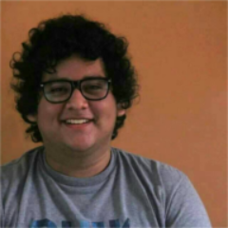
Meet José Antonio Rey
Started with charming in February
Got started working the rev Q
I talk to him daily - literally with 10 minutes of my day
Now interfaces with ISV submissions!
Has become a front line warrior in the Juju Quality Effort

Slide 3
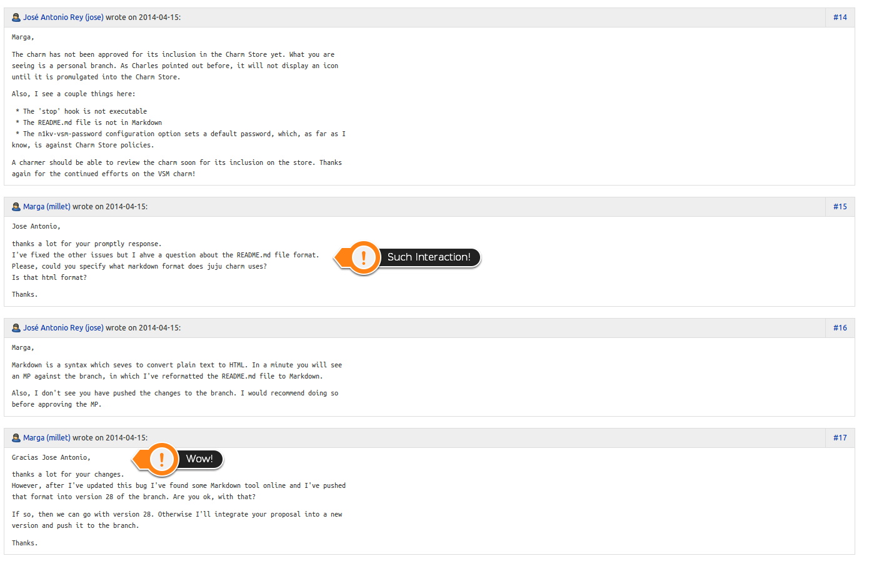
Don’t believe me?

Slide 4
A guiding hand will feed the masses
Why should I care? I’m an engineer on <awesome product description>
You are inspiring the future of Juju users
Community is a big driver of adoption
You are challenging your own understandings of Juju
Your 20 minutes a week, will yield hours of saved effort

Slide 5
Your challenge, should you choose to accept it.
Adopt a community charmer. Pass the word.

